Slide 1
Chapter 2
Content
The Design of HDFS
HDFS concepts
Command Line Interface
Hadoop file system interface
Data Flow
Data Ingest with Flume and scope and Hadoop archives.
Hadoop i/o:-Compression,serialization,Avro & File - Based Data Structure

Slide 2
HDFS:
HDFS is the primary or major component of Hadoop ecosystem and is responsible for storing large data sets of structured or unstructured data across various nodes and thereby maintaining the metadata in the form of log files.
HDFS consists of two core components i.e.
Name node
Data Node
Name Node is the prime node which contains metadata (data about data) requiring comparatively fewer resources than the data nodes that stores the actual data.
These data nodes are commodity hardware in the distributed environment. Undoubtedly, making Hadoop cost effective.
HDFS maintains all the coordination between the clusters and hardware, thus working at the heart of the system.

Slide 3
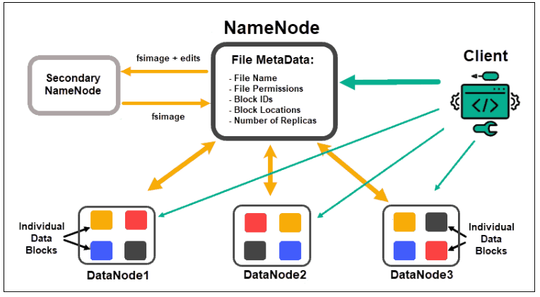

Slide 4
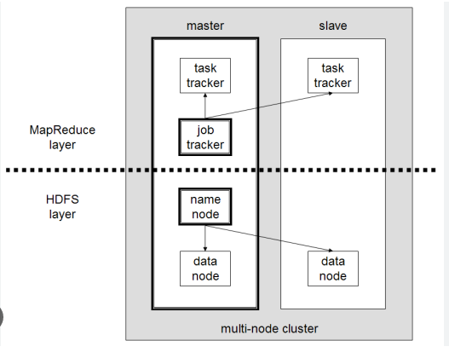
Hadoop cluster
A Hadoop cluster is a collection of computers, known as nodes, that are networked together to perform these kinds of parallel computations on big data sets.
A small Hadoop cluster includes single master and multiple worker nodes
Master Node
Data Node
Name Node
Job Tracker
Task Tracker
Slave Node
Data Node
Task Tracker

Slide 5
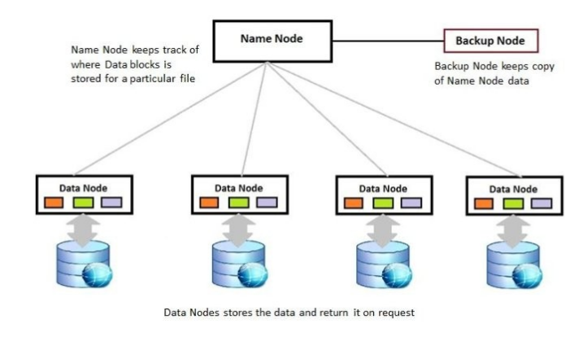

Slide 6
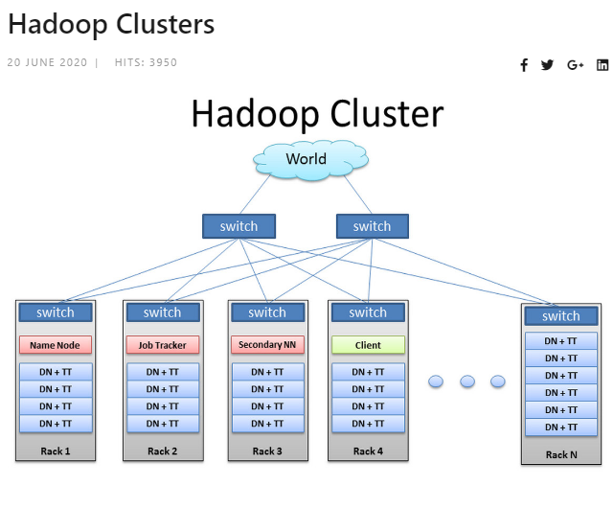

Slide 7
The Design of HDFS :
HDFS is a filesystem designed for storing very large files with streaming data access patterns, running on clusters of commodity hardware.
Very large files:
“Very large” in this context means files that are hundreds of megabytes, gigabytes, or terabytes in size.
There are Hadoop clusters running today that store petabytes of data.
Streaming data access :
HDFS is built around the idea that the most efficient data processing pattern is a write-once, readmany-times pattern.
A dataset is typically generated or copied from source, then various analyses are performed on that dataset over time.
Commodity hardware :
Hadoop doesn’t require expensive, highly reliable hardware to run on. It’s designed to run on clusters of commodity hardware (commonly available hardware available from multiple vendors3) for which the chance of node failure across the cluster is high, at least for large clusters.
HDFS is designed to carry on working without a noticeable interruption to the user in the face of such failure.

Slide 8
HDFS Concepts
Blocks:
HDFS has the concept of a blocks,which stores data in a block .
It has a capacity to store larger data —64 MB for version 1.0 and 128MB for 2.0 version.
Files in HDFS are broken into block-sized chunks, which are stored as independent units.

Slide 9
Having a block abstraction for a distributed filesystem brings several benefits.:
The first benefit :
A file can be larger than any single disk in the network.
There’s nothing that requires the blocks from a file to be stored on the same disk, so they can take advantage of any of the disks in the cluster.
Second:
Making the unit of abstraction a block rather than a file simplifies the storage subsystem.
The storage subsystem deals with blocks, simplifying storage management (since blocks are a fixed size, it is easy to calculate how many can be stored on a given disk) and eliminating metadata concerns.
Third:
Blocks fit well with replication for providing fault tolerance and availability.
To insure against corrupted blocks and disk and machine failure, each block is replicated to a small number of physically separate machines (typically three)

Slide 10
Hadoop’s Basic Data Flow
1. Capture Big Data.
2.Process and Structure.
3.Distribute Results.
4.Feedback and Retain.

Slide 11

Introduction to Flume
Defi: Flume is a
distributed,
reliable, and
available service for efficiently collecting, aggregating, and moving large amounts of log data.
or
Apache Flume is a tool/service/data ingestion mechanism for collecting aggregating and transporting large amounts of streaming data such as log files, events (etc...) from various sources to a centralized data store.

Slide 12
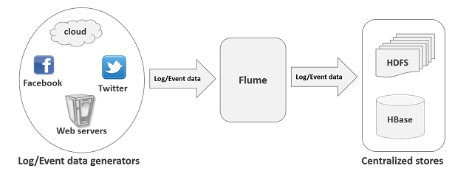
It is principally designed to copy streaming data (log data) from various web servers to HDFS.

Slide 13
Flume:-Data Transfer in Hadoop
Hadoop is an open-source framework that allows to store and process Big Data in a distributed environment across clusters of computers using simple programming models.
Streaming / Log Data
Generally, most of the data that is to be analyzed will be produced by various data sources like
applications servers,
social networking sites,
cloud servers, and
enterprise servers.
This data will be in the form of log files and events.

Slide 14
Basically, for streaming logs into Hadoop environment, Apache Flume is best service designed.
Also for collecting and aggregating huge amounts of log data, Flume is a distributed and reliable service.
Moreover, it has very simple and easy to use architecture, on the basis of streaming data flows.
Also, it has tunable reliability mechanisms and several recoveries and failover mechanisms.

Slide 15
Log file: In general, a log file is a file that lists events/actions that occur in an operating system.
For example, web servers list every request made to the server in the log files.
On harvesting such log data, we can get information about:
• the application performance and locate various software and hardware failures.
• the user behavior and derive better business insights.

Slide 16
The traditional method of transferring data into the HDFS system is to use the put command.
HDFS put Command
The main challenge in handling the log data is in moving these logs produced by multiple servers to the Hadoop environment.
Hadoop File System Shell provides commands to insert data into Hadoop and read from it.
You can insert data into Hadoop using the put command as shown below.

Slide 17
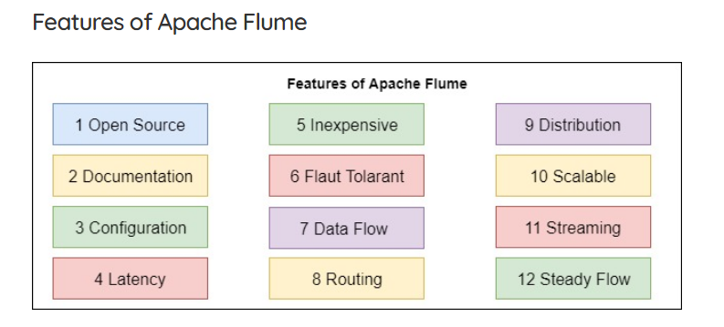

Slide 18
Applications of Flume
Assume an e-commerce web application wants to analyze the customer behavior from a particular region.
To do so, they would need to move the available log data in to Hadoop for analysis.
Here, Apache Flume comes to our rescue.
Flume is used to move the log data generated by application servers into HDFS at a higher speed.

Slide 19
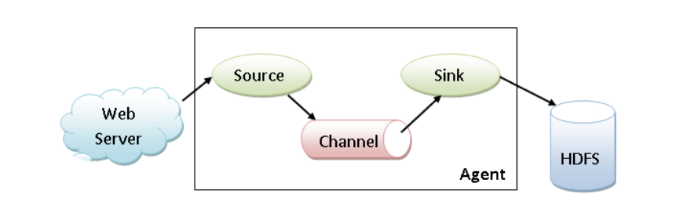
Architecture of Apache Flume
Fig:Apache Flume Agent/Architecture of Apache Flume

Slide 20
Flume Agent
An agent is an independent daemon process in Apache Flume.
Flume Agent ingests the streaming data from various data sources to HDFS.
Agent receives the data from the client or other agents and forwards it to its next destination (sink or agent).
The Flume agent contains three main components, i.e.,
source,
channel, and
sink.

Slide 21
Sqoop-(“SQL to Hadoop and Hadoop to SQL”)
Sqoop is a tool designed to transfer data between Hadoop and relational database servers.
or
Apache Sqoop(TM) is a tool designed for efficiently transferring bulk data between Apache Hadoop and structured datastores such as relational databases.
It is used to import data from
relational databases such as MySQL, Oracle
to Hadoop HDFS, and
export from Hadoop file system to relational databases.

Slide 22
It is provided by the Apache Software Foundation.
SQL-to-Hadoop.
Sqoop is a tool used to transfer bulk data between Hadoop and external datastores, such as relational databases (MS SQL Server, MySQL).
Apache Sqoop is a lifesaver in moving data from the data warehouse into the Hadoop environment.
Interestingly it named Sqoop as SQL-to-Hadoop.
Basically, for importing data from RDBMS’s like MySQL, Oracle, etc. into HBase, Hive or HDFS .
Apache Sqoop is an effective Hadoop tool.
Also, we can export data from HDFS into RDBMS through Sqoop.
In addition, Sqoop is a command line interpreter. Since interpreter executes Sqoop commands one at a time.
Sqoop got the name from sql+hadoop

Slide 23
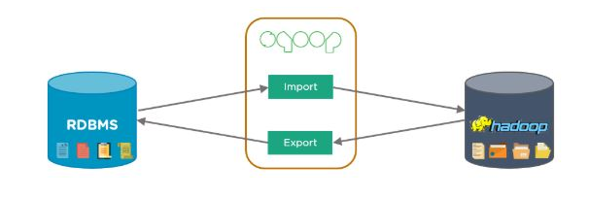

Slide 24
Sqoop Import
The import tool imports individual tables from RDBMS to HDFS.
Each row in a table is treated as a record in HDFS.
All records are stored as text data in text files or as binary data in Avro and Sequence files.
Sqoop Export
The export tool exports a set of files from HDFS back to an RDBMS.
The files given as input to Sqoop contain records, which are called as rows in table.
Those are read and parsed into a set of records and delimited with user-specified delimiter.

Slide 25
Flume:
Flume Agents have the ability to transfer data created by a streaming application to data stores like HDFS and HBase.
Sqoop:
Sqoop can be used to bulk import data from typical RDBMS to Hadoop storage structures like HDFS or Hive.

Slide 26
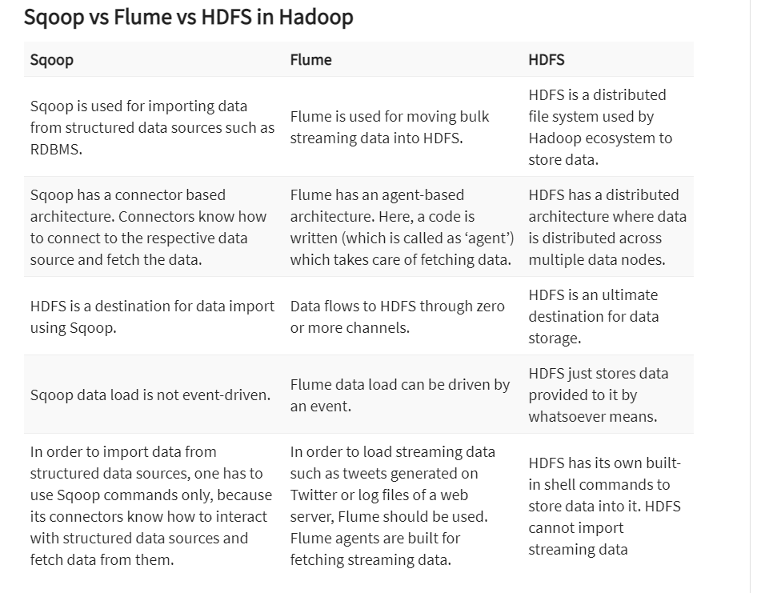

Slide 27
What is data ingestion?
Data ingestion is
the process of importing large,
assorted data files from multiple sources into a single,
cloud-based storage medium—a data warehouse, data mart or database—where it can be accessed and analyzed.
As data may be in multiple different forms and come from hundreds of sources, it is sanitized and transformed into a uniform format using an extract/transform/load (ETL) process.

Slide 28
Data Ingestion
Ingestion is the process of getting data into a system with
minimal processing or
transformation applied during ingestion.
Sqoop and Flume are two data integration frameworks that are heavily used for ingesting data into HDFS.
Which one of them you use depends on from
where the data is coming and
how you would need to use it.

Slide 29
Refrences
https://www.coursehero.com/file/46370317/Lecture9-SqoopFlumepdf/
https://www.tutorialspoint.com/sqoop/sqoop_introduction.htm

